Slide 1

AWS Storage Services
Lesson 04: AWS Storage services
Notes:
Add instructor notes here.

Slide 2
Lesson Objectives
In this lesson, you will learn:
Amazon EBS
Amazon S3
Amazon Glacier
AWS Storage gateway
Notes:
Amazon EBS
Amazon S3
Amazon Glacier
AWS Storage gateway
This lesson is to give an Introduction on Java Server Pages

Slide 3

4.1: Amazon EBS Amazon Storage Services
Cloud storage is a very crucial section of Cloud computing.
Big data analytics, data warehouses, Internet of Things, databases, and backup and archive applications all rely on some form of data storage architecture.
As compare to traditional on-premises storage systems ,Cloud storage is more reliable, scalable, and secure.
Notes:
Cloud storage is a critical component of cloud computing, holding the information used by applications. Big data analytics, data warehouses, Internet of Things, databases, and backup and archive applications all rely on some form of data storage architecture. Cloud storage is typically more reliable, scalable, and secure than traditional on-premises storage systems.
AWS offers a complete range of cloud storage services to support both application and archival compliance requirements. Select from object, file, and block storage services as well as cloud data migration options to start designing the foundation of your cloud IT environment.

Slide 4
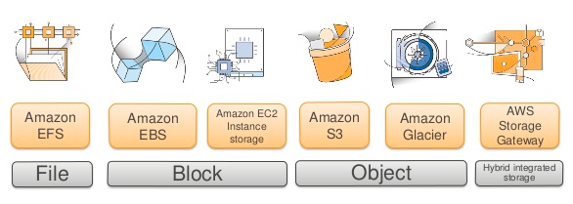
4.1: Amazon EBS AWS Storage
Notes:
AWS provides Select from object, file, and block storage services as well as cloud data migration options to start designing the foundation of your cloud IT environment

Slide 5
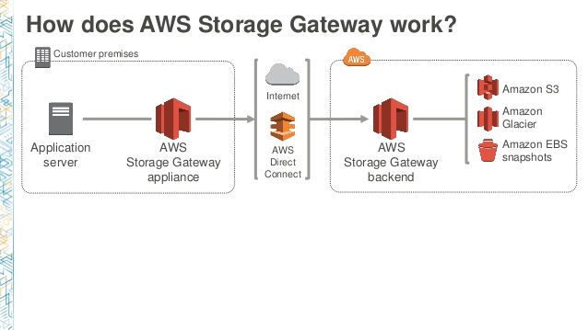
4.1: Amazon EBS Amazon Storage Services
AWS offers a complete range of cloud storage services to support both application and archival compliance requirements .
.

Slide 6
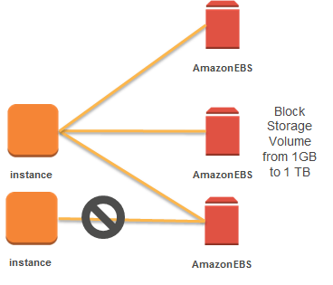
4.1: Amazon EBS Amazon EBS(Elastic Block Storage)
It provides persistent block storage volumes for use with Amazon EC2 instances in the AWS and it is private to the instances.
Notes:
Each Amazon EBS volume is automatically replicated within its Availability Zone to protect you from component failure, offering high availability and durability.
One can attach multiple volumes to single EC2 instance in the same AZ.
One can Mount EBS as drives in EC2 instance and whenever required can be formatted.
Each Amazon EBS volume is automatically replicated within its Availability Zone to protect the user from any component failure.
It offers high availability and durability .

Slide 7
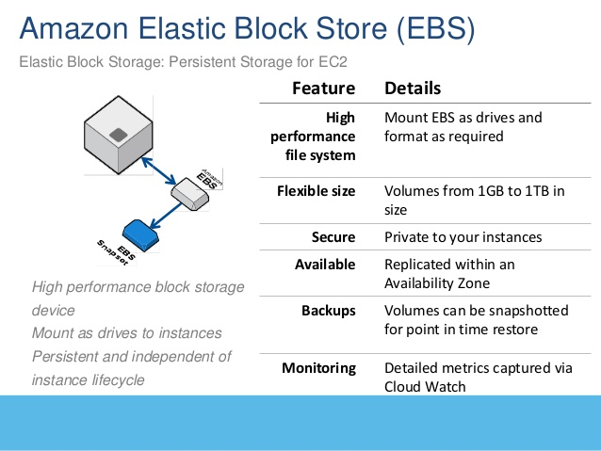

4.1: Amazon EBS Amazon EBS - Features
Notes:
Amazon EBS encryption offers seamless encryption of EBS data volumes, boot volumes and snapshots, eliminating the need to build and manage a secure key management infrastructure.
Dynamically increase capacity, tune performance, and change the type of live EBS volumes. Elastic Volumes allows you to dynamically increase capacity, tune performance, and change the type of any new or existing current generation volume with no downtime or performance impact.
By using Amazon CloudWatch with AWS Lambda you can automate volume changes to meet the changing needs of your applications.
.

Slide 8
4.1: Amazon EBS Amazon EBS - Features
It allows to choose between SSD-backed or HDD-backed volumes which can deliver the performance one need for most demanding applications.
Volumes can be snapshotted for point in time and restore
At no additional charge , Amazon EBS volume data is replicated across multiple servers in an Availability Zone to prevent the loss of data from the failure of any single component. This makes EBS volumes 20 times more reliable than typical commodity disk drives.
Access to Amazon EBS volumes is integrated with AWS Identity and Access Management (IAM). IAM enables access control to your Amazon EBS volumes.
EBS is private to one’s EC2 instance
Notes:
It allows to choose between SSD-backed or HDD-backed volumes which can deliver the performance one need for most demanding applications.
Each Amazon EBS volume is automatically replicated within its Availability Zone to protect you from component failure, offering high availability and durability.

Slide 9
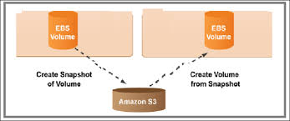
4.1: Amazon EBS Amazon EBS Snapshots
Amazon EBS provides the ability to save point-in-time snapshots of your volumes to Amazon S3.
Amazon EBS Snapshots are stored incrementally.
When one delete a snapshot, he/she removes only the data not needed by any other snapshot.
Snapshots can be used to instantiate multiple new volumes, expand the size of a volume, or move volumes across Availability Zones.
Notes:
Amazon EBS Snapshots are stored incrementally: only the blocks that have changed after your last snapshot are saved, and you are billed only for the changed blocks. If you have a device with 100 GB of data but only 5 GB has changed after your last snapshot, a subsequent snapshot consumes only 5 additional GB and you are billed only for the additional 5 GB of snapshot storage, even though both the earlier and later snapshots appear complete.
When one delete a snapshot :-
All active snapshots contain all the information needed to restore the volume to the instant at which that snapshot was taken. The time to restore changed data to the working volume is the same for all snapshots.

Slide 10
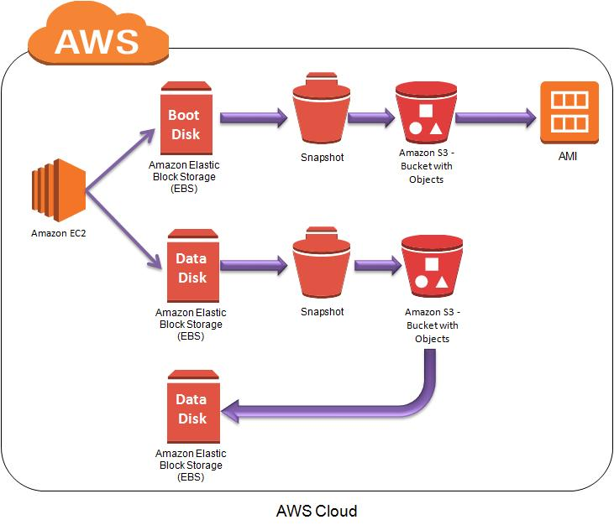
4.1: Amazon EBS Amazon EBS

Slide 11
4.1: Amazon EBS Demo
Demo on:
Amazon EBS ( Refer Steps in Note section )
Notes:
Step 1 : Go to EC2 dashboard and click on Volume
Step 2 : Click on Create volume
Step 3 : Select Volume type and Add a Tag
Step 4 : Click on Create Volume button
Step 5: Select the volume and attach it
Step 6: Note the Linux Device path
Step 7 : Click on Attach button
For Mounting your Volume , Go to Putty and type the below command
Step 1 : lsblk
Step 2 : sudo file – s /dev/xvdf
Step 3 : sudo file –s /dev/xvda1
Step 4 : sudo mkfs -t ext4 /dev/xvdf
Step 5 : sudo mkdir /data

Slide 12

4.2: Amazon S3 Amazon S3(Simple Storage Service)
Amazon S3 is the storage for the Internet , which is designed to make web-scale computing easier for Developers .
It provides a simple web services interface which can be used to store and retrieve any amount of data, at any time, from anywhere on the web(i.e. web sites, mobile apps, corporate applications, and data from IoT sensors or devices) .
The service aims to maximize benefits of scale and to pass those benefits on to developers.

Slide 13
4.2: Amazon S3 Amazon S3(Simple Storage Service)
The container for objects stored in Amazon S3 is called an Amazon S3 bucket .
Amazon S3 is the most supported cloud storage service available, with integration from the largest community of third-party solutions, systems integrator partners, and other AWS services.
Store and retrieves digital files.
Amazon S3 allows you to run sophisticated Big Data analytics on your data without moving the data into a separate analytics system

Slide 14
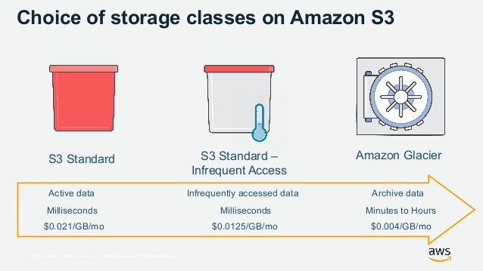
4.2: Amazon S3 Amazon S3(Simple Storage Service)

Slide 15
4.2: Amazon S3 Demo
Demo on:
Creating Amazon S3 bucket and upload a file into Bucket
Notes:
Follow the steps to Create a S3 Bucket and upload the file into the bucket
Step 1 : Choose S3 under storage service and click on Create Bucket button
Step 2 : Provide a Bucket Name and choose the Region
Step 3 : Click on Next
Step 4: Don’t change anything in SetProperties window and click Next
Step 5: You can add one more Account and click on Read permission click on Save button
Step 6 : If you want give the public read permission to this bucket and click on Next
Step 7: Review it and click on Create Bucket button
Step 8: Close this window and see your Bucket from list
Step 9: Click on your Bucket and go to properties tab
Step 10 : Click on Static web hosting tab
Step 11 : choose “use this bucket to host your web site “
Step 12 : Provide the index document name and click on Save button
Step 13 : Come to Overview tab and choose a file and upload it
Step 14 : Click on the file you uploaded
Step 15 : Click on make public button
Step 16: Click on the link and see your file

Slide 16
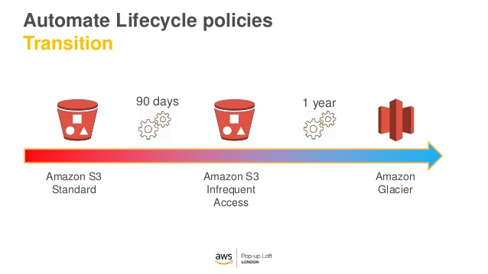
4.3: Amazon Glacier Amazon Glacier
Amazon Glacier is an extremely low-cost storage service that provides secure and durable storage for data archiving and backup .
It is the storage for infrequently accessed data .
Notes:
Even lower cost than Amazon S3 with Same high durability.
With Amazon Glacier, customers can reliably store large or small amounts of data for as little as $0.01 per gigabyte per month, which is always better then on-premises solutions

Slide 17
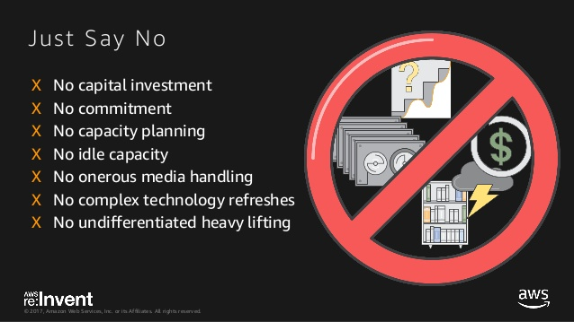
4.3: Amazon Glacier Amazon Glacier
Amazon Glacier allows us to pay only for what we use.
.
Notes:
Amazon Glacier allows us to pay only for what we use.
.
For data archiving and backup no need to pay any upfront money.one can pay the low price for storage, and can scale your usage up or down as needed .
It is easy to use.
Amazon Glacier is the only cloud archive storage service that allows you to query data in place and retrieve only the subset of data you need from within an archive

Slide 18
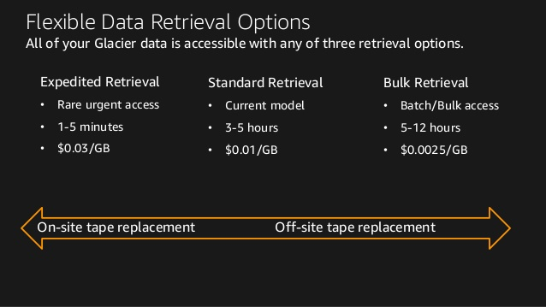
4.3: Amazon Glacier Amazon Glacier
Notes:
Just Say No :--
capital investment
No commitment
No capacity planning
No idle capacity
No onerous media handling
No complex technology refreshes
No undifferentiated heavy lifting

Slide 19
4.4: Amazon Storage gateway AWS Storage gateway
It is a hybrid storage service which enables the on-premises applications to seamlessly use AWS cloud storage.
It provides three interface in a data center and it connects those three interface to AWS storage.
Files
Volumes
Tapes
It brings the AWS storage to your application by using a standard protocol.

Slide 20
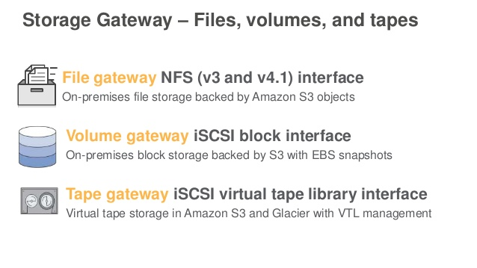
4.4: Amazon Storage gateway AWS Storage gateway
Notes:
Iscsi - Internet Small Computer Systems Interface, an Internet Protocol (IP)-based storage networking standard for linking data storage facilities. It provides block-level access to storage devices by carrying SCSI commands over a TCP/IP network.
NFS :-- Network File System (NFS) is a distributed file system protocol originally developed by Sun Microsystems in 1984, allowing a user on a client computer to access files over a computer network much like local storage is accessed. NFS, like many other protocols, builds on the Open Network Computing Remote Procedure Call ...

Slide 21
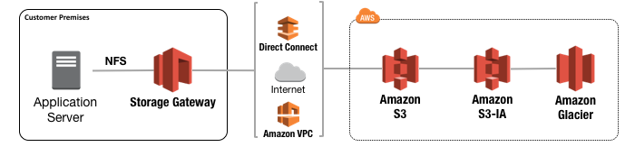
4.4: Amazon Storage gateway AWS File Storage gateway
The File Gateway configuration offers on-premises servers and applications a network file share via an NFS connection.
For the local performance ,File data is cached on the File Gateway and converted to objects stored in Amazon S3.
Notes:
The File Gateway configuration offers on-premises servers and applications a network file share via an NFS connection.
For the local performance ,File data is cached on the File Gateway and converted to objects stored in Amazon S3.
In the data center Data moves to AWS storage through a Protocol called as NFS .

Slide 22
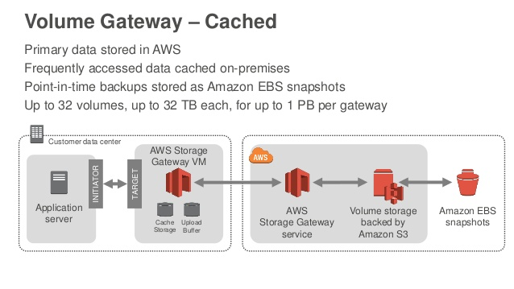
4.4: Amazon Storage gateway AWS Volume Storage gateway

Slide 23
Summary
In this lesson, you have learnt:
Amazon EBS
Amazon S3
Amazon Glacier
AWS Storage gateway

Slide 24
Review – Questions
Question 1: ___________ is a hybrid storage service which enables the on-premises applications to seamlessly use AWS cloud storage .
Question 2 : The container for objects stored in Amazon S3 is called an ____________ .
Notes:
Answers for the Review Questions:
Answer 1: Amazon Storage gateway
Answer 2: Amazon S3 Bucket

Slide 25
Review – Questions
Question 3: _________ AWS storage basically stores the for infrequently accessed data and lower cost than Amazon S3 .
Question 4: Which is the AWS Block storage ?
Option 1 : Amazon EBS
Option 2 : Amazon S3
Option 3 : Amazon Glacier
Option 4 : Amazon Cloudfront
Notes:
Answers for the Review Questions:
Answer 3 AWS Glacier
Answer 4: Option 1

